Slide 1

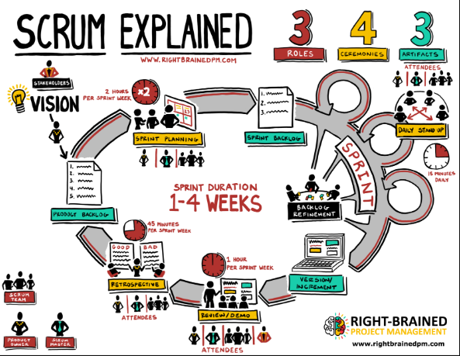
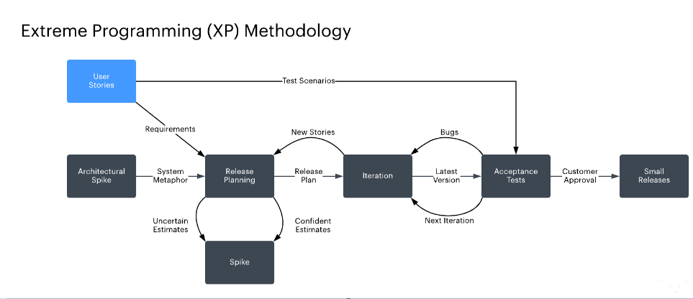
Secure DevOps Life Cycle
Ms. Madhuri Gedam, Research Scholar, Computer Engineering Dept.,VJTI, Mumbai
Dr. B. B. Meshram, Professor, Computer Engineering Dept.,VJTI, Mumbai
Poster No. CE-
2020
Roll No. - 11
Abstract
Literature Review
XP consists of 12 related practices and works best for small teams of 5 to 15 developers. Rather than focus on paper-based requirements and design documentation, XP concentrates on producing executable code and automated test drivers. This focus on source code makes XP controversial, leading some to compare it to hacking. We believe this comparison is unjustified because XP highly values simple design, and counters hacking claims by emphasizing refactoring, strong regression testing, and continuous code inspections through pair programming.[3]
XP practices includes:
Customer Satisfaction ,On-site customer, Software Quality , Metaphor , Testing , Small releases.
Paired programming is touted as a very useful development practice. This concept encourages developers to code review (each other) all the time and removes some of a programmerk bias towards his or her own code. In the case of high algorithmic or information complexity, paired programming helps developers to better understand the project as they design and develop code together. Highly experienced and valuable team members can be paired with new, or inexperienced members. This allows the transfer of knowledge and experience throughout the project team, between pairs. Finally, this socialization process minimizes the need for extensive documentation. Having made the above statements, four months into the project the team discontinued this practice. Team members felt that paired programming was a waste of time. They cited the following reasons: Scheduling between pairs in a university setting was extremely difficult. Unlike industry with a set of common hours, partners’ schedules were never aligned for extensive periods of time. In the event that pairs were programming known or accepted code, like standard data structures and algorithms, there was no sense in having two people. Finally, there were no experienced developers to pair up with and learn from.[3]
this paper discuss about two agile methods for software development process which are extreme programing and scrum .extreme programming (XP) is a software development methodology that is intended to improve software quality and responsiveness to change. scrum was developed to be a flexible alternative to heavyweight project management frameworks like waterfall.in this paper a brief discussion about both the models is carried out and comparison of both the model is carried out to have a better understanding of both the models. extreme programming is based on a sequence of development practices, including pair programing, very accurate configuration management, strong customer interaction based on 'system stories, "detailed testing. there are various frameworks for agile but some can be more complex or overwhelming to agile beginner and so amongst all, scrum provides an easy method to implement agile. scrum is currently the top most technique used in development not only for software but even in the fields of finance, research etc. software quality is essential to software development projects, from the aspects of the customer, sponsor, development team and quality assurance team.
Workflow of scrum consists of close collaboration of scrum team and Master with Product owner over continuous iterations of the evolving software. The scrum process involves a scrum Master, the Product Owner and the scrum Team. The scrum Masters’ main role is to eliminate impediments. The team of scrum is a cross functional one which comprises of developers, testers and other experts of various fields required in development which leads to a versatile and innovative end product that meets the satisfaction of the customer.[4]
Figure 1:Scrum Cycle
A sprint is the smallest block of scrum which has a small team that works on assigned task. It lasts for 1 to 3 weeks. The task for a sprint is decided by a sprint backlog. Sprint backlog is a documentation of all the requirements for current sprint to be worked on.The product backlog is a roster of requirements which are determined by the product owner and are called user stories. It is broken up into sprint backlogs followed by sprint planning which includes methods to get a sprint done. At the end of each day a daily scrum takes place aimed at progress of the task assigned for the day. The aim of each sprint is to deliver a potentially shippable product. At the end of the each sprint there is sprint review that takes place with the product owner to demonstrate the shippable product increment. Scrum focuses on productivity through communication and planning that provide freedom to teams for discovering ways to engineer solutions. It also provides a more efficient process in case a fundamental shift is required. Also, scrum is best suited for teams that can concentrate entirely on the development of the project or a product in hand. Some of the other advantages include lowering of cost due to constant communication and increase in quality by ensuring that all teams are aware of problems and changes. [4].Flexibly combination of design methods is one of effective tools for rapid design. During the stage of concept design, different design methods are selected to use for different products. Design efficiency and quality are closely related to combination of selected methods. Scrum is the agile method driven by demand, which is suitable for industrial design practice of creativity[3]
Introduction
XP consists of 12 related practices and works best for small teams of 5 to 15 developers. Rather than focus on paper-based requirements and design documentation, XP concentrates on producing executable code and automated test drivers. This focus on source code makes XP controversial, leading some to compare it to hacking. We believe this comparison is unjustified because XP highly values simple design, and counters hacking claims by emphasizing refactoring, strong regression testing, and continuous code inspections through pair [3] Originally, Scrum is proposed for software development. Currently, it is one of most popular and effective ideas and methods for agile project management. It is a kind of iterative and incremental development method, at the same time is the adaptive development process . The target of Scrum is to deliver software products with as well as high quality after series of defined periods. Here a "defined period" is called a Sprint. The whole development cycle includes demand, analysis, design, iteration and production.[2]
Figure 2: Extreme Programing Methodology
Conclusion
References
In the following poster a proper comparision of two agile model was giving the detailed information about the two methodology that includes Scrum and Extreme Programing (XP).The common theme throughout this discussion has been the teak actual experience while implementing the Extreme Programming methodology. The XP paradigm presents an ideal framework within which to complete a software project. XP’s 12 core practices are closely related, and implementing only a few will not necessarily bring all potential benefits. For example, you cannot have people modifying the entire code base without automated test drivers in place. On the other hand, some practices can be adopted in any case; automated test drivers and continuous integration will help any software development project Scrum has the ability to cater to the needs of thousands of projects and can very well be scaled to large amounts. It is the small aspects of its implementation that are having significant issues like lack of automation in workflow and testing, better management support and unavailability of experienced team workers.
Madhuri N. Gedam, Bandu B. Meshram, "Vulnerabilities & Attacks in SRS for Object-Oriented Software Development,“, WCECS 2019, 22-24 October, 2019, San Francisco, USA, pp94-99 (Scopus indexed paper)
Madhuri N. Gedam, Varshapriya J.N, Bandu B. Meshram, "Proposed Secure Content Modeling of Web Software Model," IJETT, NCRIEST - 2019, Vol. 6, August 2019. (Received Best Paper in a Conference Award)
Madhuri N. Gedam, Varshapriya J.N, Bandu B. Meshram, "Cloud:SaaS Availability," IJETT, NCRIEST - 2019, Vol. 6, August 2019.
Notes:
1

